Slide 1
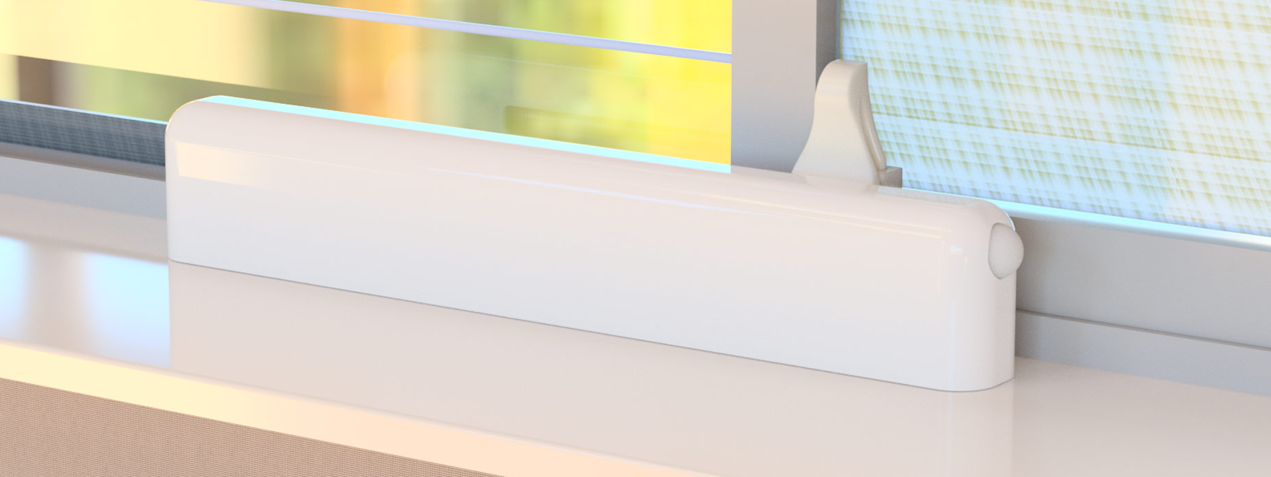
Jesús F. Treviño Daniel E. Treviño
Misael Pérez

Slide 2
Agenda
Team
fenestra overview
What we do & why
Value proposition
fenestra v1.0
Technology details
Business overview
Mission & objective
Competitive overview
Synergies (economic uplift)
Disruptions
Go to market plan
Market size
Beachhead market segment
Kickstarter Campaign
Product development
Key milestones & phases
Test plan
Kickstarter campaign prototypes
Post successful Kickstarter prototypes
Expected CoGS & Pricing (Gross Margin)
Long term product roadmap
Notes:
2

Slide 3
Team
Jesús F. Treviño Founder and CEO Mechanical Engineer, Tecnológico de Monterrey
MBA, Carnegie Mellon University
Directly responsible for production launches in the USA and Mexico for the automotive industry.
Team member for production launches in China for gaming consoles and tablet computers.
Daniel E. Treviño Co-Founder and CTO Software Engineer, Tecnológico de Monterrey
Over 9 years of experience in the embedded software industry working for Qualcomm and Texas Instruments. Have successfully contributed in launching mobile phones to all major U.S. wireless carriers.
Misael Pérez Lead Hardware Engineer
Electronics Engineer, Universidad de Guadalajara
Robotics, Kanazawa Institute of Technology
Over 10 years of experience in design, test and manufacture of consumer electronics ranging from servers and game consoles to wearables.

Slide 4
What we do & why
fenestra improves people's health
FACT- Air inside your home is dirty, in fact, it's 5x to 10x as dirty as the air outside.
People would like to open their windows more often but are often concerned of outdoor weather, pollen, or pollution
fenestra understands outdoor conditions, and automatically opens and closes the windows in your home at precisely the right moment.
Fresh air from the outdoors circulates through your home, and flushes out dirty and stuffy air.

Slide 5
What we do & why
fenestra saves people money
FACT- People spend 20% of their energy bill cooling their home.
Some people would like to open their windows more often but are not able to do this since they are not home, or awake, when the time is right
fenestra automatically opens your windows when the outdoor temperature and humidity are just right.
This inflow of cool air from the outdoors helps decreases the use of A/C and can lower your bills 10% to 30%.

Slide 6
What we do & why
fenestra gives people peace of mind
User interviews revealed that most people feel worried about opening their windows and leaving them unsupervised.
fenestra removes this worry by using motion sensors and monitoring your windows even while open.
At any sign of tampering, fenestra will notify you and can activate numerous alarm actions.

Slide 7
What we do & why
fenestra makes life practical
Most people are aware that opening windows in order to let fresh air in is beneficial; yet they don’t do it often because it’s inconvenient
fenestra leverages the latest IoT technology, and transforms the passive home window, into an active and smart component of the home ventilation system.

Slide 8
Value proposition
FOR:
Tech savvy home owners who value their health, saving money, and sustainability
WHO:
Value the feeling of fresh air in their homes but find it inconvenient and risky to open the windows around their home
OUR PRODUCT:
Will revolutionize home ventilation by optimizing the time of day when the windows in a home are open. By tracking real time weather data, air quality, and your desired home temperature, fenestra will seamlessly open your windows at exactly the right time
PROVIDES:
A smart system that will refresh your home, save you energy, and keep your home safe
UNLIKE:
Having to operate and maintain costly air filtration equipment; having to constantly operate your air conditioning; having to open and close your windows manually while looking out for weather changes, and the security of your home.

Slide 9
fenestra v1.0 (MVP)
Device which automates horizontal sliding windows
Two way interaction with your smartphone or tablet via the SmartThings App (iOS & Android)
Battery operated & charged by solar panel
Able to get detailed information on outdoor conditions like weather and air quality by communicating with web API’s
Able to sense indoor temperature, humidity, and react
Self locking, able to sense movement, and react with alarm actions to keep your home safe
Compatible with popular web based services such as IFTTT, Amazon Echo, and Google Home
Simple to install/remove; mounted at the base of the window
Notes:
Live demo (or video) after this slide

Slide 10
Tech Specs
Motor: 6 volt electric motor mechanism with digital encoder.
Sensors: Temperature, presence, and movement sensors onboard.
Chipset: ATMEL® Microcontroller + Microchip ZigBee® radio module.
Connectivity: Samsung SmartThings®.
Power: High capacity LiO battery charged by a 6.5 watt solar panel.
Operation: Controlled using any iOS or Android smartphone/tablet via the SmartThings® app.
Control Range (May Vary): 325 feet (100 meters).

Slide 11
Mission & Business objective
fenestra mission
Improve people’s health and help them save energy by automating and keeping safe an integral part of their home.
fenestra business objective
Become the market and technology leader of smart window solutions to both consumers and window OEM’s.
Make fenestra a brand synonymous with smart window solutions.

Slide 12
Competitive overview
 | Technology | Advantages | Disadvantages
Alternatives | Manual Open-Close | No added costs | Not optimal Difficult to execute Safety (un-guarded) May be counterproductive is outdoor weather changes
Substitutes | Indoor air filters | No perceived danger of open windows | Energy consumption (one / room). Noise. Cumbersome. Cost of equipment + replacing filters.
 | Ceiling and floor fans | Immediate relief from feeling heat | Helps heat sensation, but does not cool or replace the air inside homes
Complements | Air quality monitors | Real time monitoring and reporting of indoor air quality | Can’t act on such information. fenestra could act on this information
 | Whole house fans | Very efficient method to use outside cool air to ventilate and cool a home | System is operated using a switch or a timer. Also, needs windows to be open. fenestra could automate windows and bring weather intelligence to the system

Slide 13
Synergies
User interviews and analysis of the competition showed a couple of sectors where fenestra will present synergy opportunities
Window OEM’s
Current windows are “off line” and Window OEM’s may not want to build in their organizations an IoT/Smart Home team.
fenestra could be the strategic supplier of the hardware and mechanism to automate windows. Also, provide the integration of the window to SmartThings, and other Smart Home platforms.
Indoor air quality (IAQ) monitors
Current IAQ monitors measure and alert the homeowner when IAQ is poor.
fenestra could ACT upon that information and open the home windows to improve IAQ.
Whole House Fans (WHF)
Current WHF systems are controlled using a switch or a timer. They depend on cool outdoor air to cool the home. Additionally, the home windows need to be open for the system to operate efficiently.
fenestra could automate windows, bring weather intelligence to the system, and control the fan operation
Home Alarm Systems and Providers
Current alarm system need all windows to be closed in order to be armed
fenestra could provide a surveillance method for windows, whether the window is closed or open

Slide 14
Disruptions
… the flip side of the coin also exists. In these sectors fenestra can present disruptions
Indoor air filters and air purifiers
Currently home owners operate air filters/purifiers to clean their indoor air. Most of these work only on individual rooms, are noisy, consume electricity and filters.
fenestra not only reduces the need for air filters, it also changes the air and increases the oxygen level inside the home. CO₂ that accumulates indoors does not get filtered out by air filters!
Air Conditioning
Current A/C load needs are calculated using the size of the home and the cooling hours needed.
fenestra will reduce the amount of cooling hours required to make a home comfortable year round. This change will mean smaller A/C units needed at homes in many regions.

Slide 15
Market size
30 Million households projected to add Smart Home technology in next 12 months (April, 2016)¹
Morgan Stanley analyst Scott Devitt estimates Nest is selling 100,000 thermostats per month²
Parks Associates IoT market research estimates Ecobee is selling 83,000 thermostats per month³
How will home owners react to fenestra given these favorable market conditions for smart home technology?
Exactly what we want to answer
1 http://corporate.comcast.com/news-information/news-feed/thirty-million-u-s-households-projected-to-add-smart-home-technology-in-next-12-months
2 http://www.businessinsider.com/nest-revenue-2014-1
3 http://www.forbes.com/sites/aarontilley/2015/09/28/thermostat-wars-with-help-from-apple-ecobee-takes-number-two-place-behind-nest
Notes:
15

Slide 16
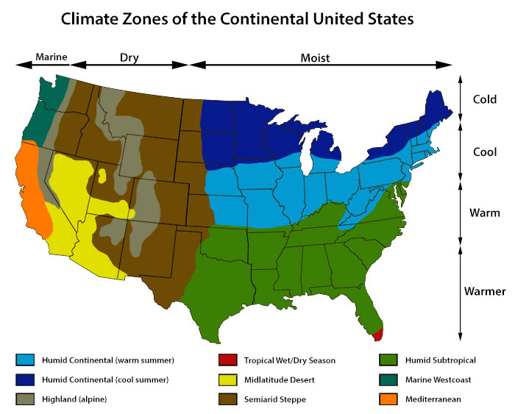
Beachhead market segment (MVS)
Homeowners who:
like technology and brag about their gadgets
have, or looking to have SmartThings
have, or looking to have a smart thermostat
mainly horizontal sliding windows in their home
live in target climate zone (highlighted)
concerned about IAQ due to allergies/asthma
energy conscious / sustainability

Slide 17
Go to market: Kickstarter campaign
Objective
Minimize risk & capital needs by building inventory on pre-orders only
Gather intelligence on the customers response for this technology:
Demographics of project backers
Main concerns, questions, doubts, etc.
User cases and scenarios
Sales funnel conversion rates
Marketing for fenestra and smart window technology
Finalize development for manufacturing

Slide 18
Product development milestones
 | EPv1 & v2 | EVT | DVT | PVT or 1st Batch | Mass Production
General Objective | Integrate complete package on final design | Plastic tooling w/o finalized cosmetics Try-out brackets from hard tooling / equipment Test plan detail by type Beta units for 3rd party | Final validation test before sellable units Plastic molds final cosmetics Optimizing for CoGS Test plan detail by type Beta units for 3rd party | Full line setup (garage version) Analysis yield, volume, time, rework time... Final QA/QC processes | Sub-Contract Final Assembly & Testing CoGS Optimization
Quantity Prototypes | 1 - 5 | 10 - 15 | 15 - 20 | 500 | +1,000
Notes:
18

Slide 19
Product development test plan
 | EPv1 & v2 | EVT | DVT | PVT or 1st Batch | Mass Production
Mechanicals Assembly | Component packaging Belt mechanism Threaded rod pitches Installation @ Window | Form cosmetics Assembly testing Solar Wiring Harness Installation in different windows Durability testing Full functional testing | Fit & finish cosmetics Final supplier testing and award Assembly time per unit (direct labor) Assembly quality testing | Final implementation engineering changes Full assembly QA/QC | Test components CoGS optimization Full assembly QA/QC
Hardware | Architectural integration testing. Use case scenario validation. | Electrical and thermal verification of analog/digital components. Initial factory testing and programming. | Final electrical design verification, performance and reliability testing. Final factory assembly, programming and test. | Manufacturing stability and process improvements for manufacturing robustness.
Software Firmware | Testing of new hardware/software integration with new PCB. Verify differences in mechanical performance and make changes as needed. | Power consumption optimization development with finalized PCB board. | Monkey and stability testing. Final onboard PCB testing. | Changes derived from QA/QC testing and feedback.
Notes:
19

Slide 20
Product development prototypes
Pre-Kickstarter Campaign
Dev Phase | Timing [Wks.] | Dev Units | Objectives
EPv1 | Current | 1 | Show & Tell
EPv2 | +5 | 4 | Show & Tell – Demo Units Integrated PCB Improved Alarm & Movement Integrated Solar Panel Marketing Campaign

Slide 21
Product development prototypes
Post-Kickstarter Campaign → Production Launch
Dev Phase | Timing [Wks.] | Dev Units | Objectives
EVT | 6 | 10 | Plastic mold tooling w/o finalized cosmetic finish Manufacturing, PCBA, & Mechanism Testing Beta units for ViP 3rd party
DVT | 8 | 15 | Final validation test before sellable units Plastic molds tooling final cosmetic Optimizing for CoGS Beta units for 3rd party
PVT (1st Batch) | 10 | Kickstarter Volume | Full line setup Analysis yield, volume, time, rework time... Final QA/QC processes

Slide 22
Expected CoGS & Pricing
 | EP | EVT | DVT | PVT or 1st Batch | Mass Production
Mechanicals | $260.60 | $65.15 | $65.15 | $60.15 | $54.05
Hardware | $86.24 | $79.61 | $79.61 | $26.29 | $20.34
Total Direct Material | $346.84 | $144.76 | $144.76 | $86.44 | $74.39
Average Selling Price |  |  |  | $175.00 | $165.00
Notes:
22

Slide 23
Long term product roadmap
For fenestra v1.0, we are laser focused: just one just one type of window, on just one Smart Home platform.
Our long target though, is to have a solution for every type of window and every major platform.
Generation | Description
fenestra v1.0 | Attachment for horizontal sliding windows
fenestra v2.0 | Attachment for vertical sliding windows
fenestra v3.0 | Connectivity on additional platforms (Apple Home Kit – Google Brillo)
fenestra v4.0 | Turn-Key solution for window OEM’s (Pella, Andersen Windows, Milgard…)
Notes:
23

Slide 24
In Depth Slides

Slide 25
In Depth: Security
User interviews revealed that most people feel worried about opening their windows and leaving them unsupervised.
SmartThings secure wireless communications and back-end
Onboard electronics: loud piezo buzzer + presence (IR Sensor) & movement (Accelerometer) sensors
Homeowner can adjust window opening amount and opt for small opening when away from home
Alarm escalation:
Movement and/or presence triggers audible alarm, closes window, and sends notification
Interference during alarm triggers second alarm, sends emergency notification
Using IFTTT further actions can be taken for second alarm like a direct phone call to homeowner or neighbor
Future development: Integrate with 3rd party security systems and components

Slide 26
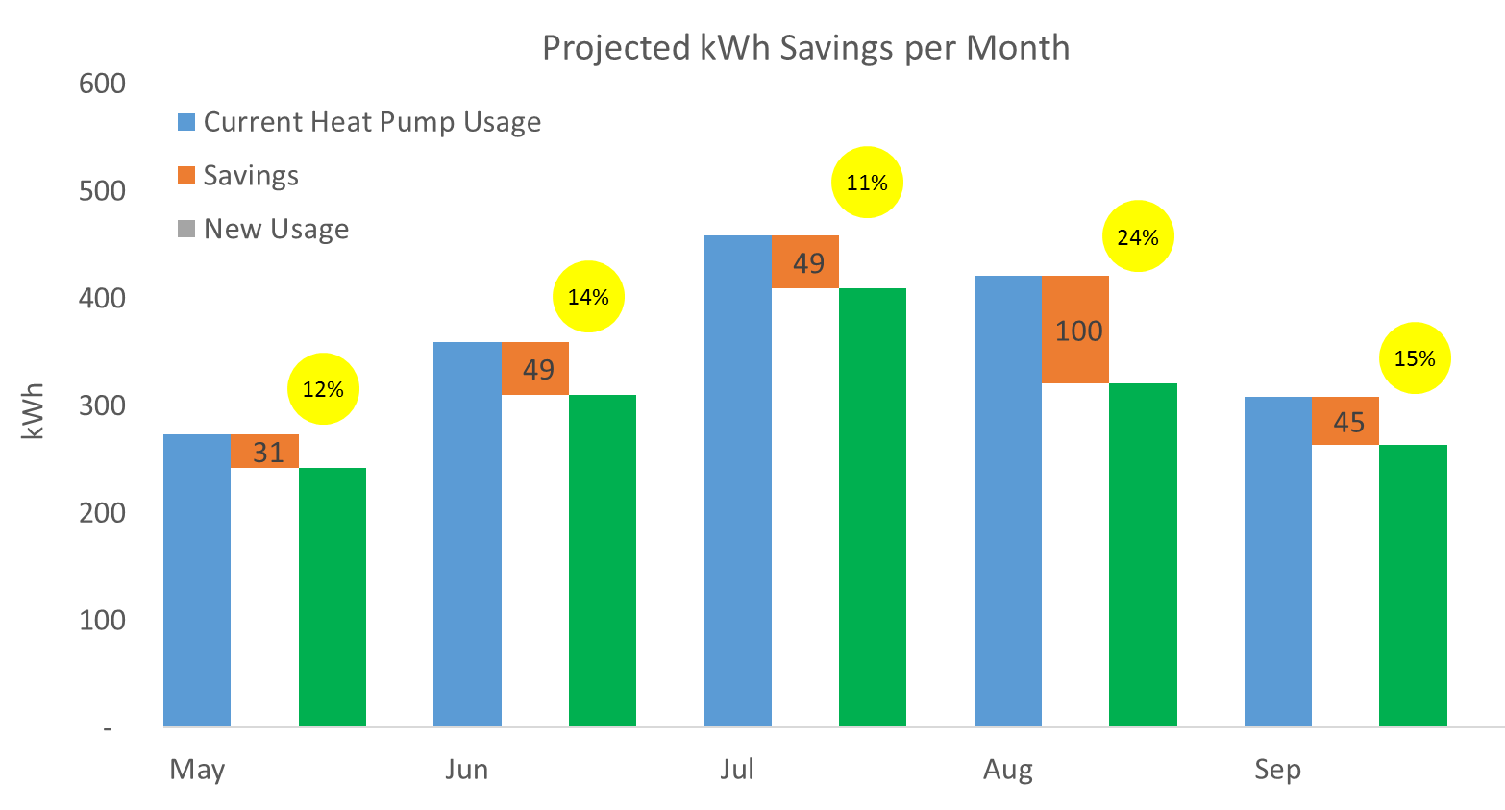
In Depth: A/C energy savings
Analysis of the data from the Net-Zero Energy Residential Test Facility (NZERTF) helped us explore energy saving strategies. Our insights lead us to design an algorithm which operates the home windows based on weather conditions.
The graph shows the amount of energy used for A/C each month, followed by the opportunity our algorithm identified, and finally the projected energy use. The yellow balloons show the percentage savings expected for each month.

Slide 27
In Depth: Safety
User interviews revealed that people feel concerned about their windows moving without notice, while kids and pets are around. Also mentioned were concerns for emergency situations.
Onboard electronics carefully track movement of the window and can detect obstructions. In case of an obstruction, fenestra will reverse its movement to avoid pinching a pet or person and notify the homeowner.
A quick release mechanism allows the homeowner to open or close the window in case there is no power on the device or in an emergency.

